Slide 1
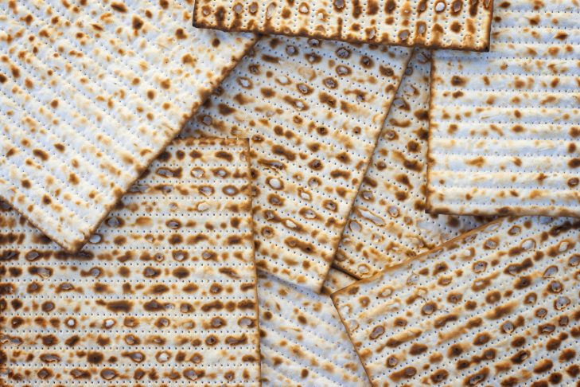
Haggadah
Passover 5780

Slide 2
Candle Lighting
בָּרוּךְ אַתָּה יְיָ, אֱלֹהֵינוּ מֶלֶךְ הָעוֹלָם, אֲשֶׁר קִדְּשָׁנוּ בְּמִצְוֹתָיו וְצִוָּנוּ לְהַדְלִיק נֵר שֶׁל יוֹם טוֹב.
Baruch atah Adonai, Eloheinu Melech ha-olam, asher kid'shanu b'mitzvotav v'tzivanu l'hadlik ner shel Yom Tov.
Blessed are You, our God, Ruler of the world, who sanctifies us with mitzvot and calls upon us to kindle the lights of the Festival Day.

Slide 3
Shehecheyanu
בָּרוּךְ אַתָּה יְיָ, אֱלֹהֵינוּ מֶלֶךְ הָעוֹלָם, שֶׁהֶחֱיָנוּ וְקִיְּמָנוּ וְהִגִּיעָנוּ לַזְּמַן הַזֶּה.
Baruch atah Adonai, Eloheinu melech ha-olam, shechecheyanu, v’kiyamanu,
v’higiyanu lazman hazeh.
Blessed are You, Adonai our God, Sovereign of the universe, who has granted us life and sustenance and permitted us to reach this season.

Slide 4
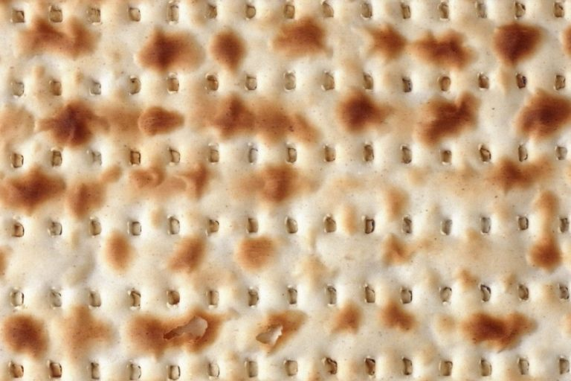
Teach your children the history of freedom if you want them never to lose it.
- Rabbi Jonathan Sacks

Slide 5
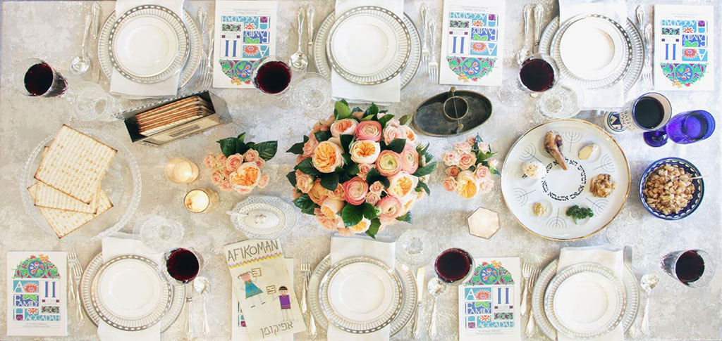
At Your “Seder Tables”
Introduce yourself.
How has being in a “narrow place” the last several weeks changed your perspective on freedom?

Slide 6
Order of the Seder
קַדֵּשׁ
וּרְחַץ
כַּרְפַּס
יַחַץ
מַגִּיד
רָחְצָה
מוֹצִיא
מַצָּה
Kadesh - Sanctification
Urchatz - Washing
Karpas - Renewal
Yachatz - Breaking Middle Matzah
Maggid - Telling the Story
Rachtzah - Washing
Motzi Matzah - Prayer for beginning of meal
מָרוֹר
כּוֹרֵךְ
שֻׁלְחָן עוֹרֵךְ
צָפוּן
בָּרֵךְ
הַלֵּל
נִרְצָה
Maror - Bitter Herbs
Korech - Hillel’s Sandwich
Shulchan Orech - Meal
Tzafun - Afikomen
Barech - Saying Grace
Hallel - Psalms of Praise
Nirtzah - Conclusion

Slide 7
Kadesh
בָּרוּךְ אַתָּה יְיָ, אֱלֹהֵינוּ מֶלֶךְ הָעוֹלָם, בּוֹרֵא פְּרִי הַגָּפֶן.
Baruch atah, Adonai Eloheinu melech ha-olam, borei p’ree hagafen.
Blessed are you, Adonai our God, Sovereign of the Universe, who creates fruit of the vine.

Slide 8
בָּרוּךְ אַתָּה יְיָ אֱלֹהֵֽינוּ מֶֽלֶךְ הָעוֹלָם, אֲשֶׁר בָּֽחַר בָּֽנוּ מִכָּל עָם וְרוֹמְמָֽנוּ מִכָּל לָשׁוֹן, וְקִדְּשָֽׁנוּ בְּמִצְוֹתָיו. וַתִּתֶּן לָֽנוּ יְיָ אֱלֹהֵֽינוּ בְּאַהֲבָה שַׁבָּתוֹת לִמְנוּחָה וּמוֹעֲדִים לְשִׂמְחָה, חַגִּים וּזְמַנִּים לְשָׂשׂוֹן, אֶת יוֹם הַשַּׁבָּת הַזֶּה וְאֶת יוֹם חַג הַמַּצּוֹת הַזֶּה, זְמַן חֵרוּתֵֽנוּ מִקְרָא קֹֽדֶשׁ, זֵֽכֶר לִיצִיאַת מִצְרָֽיִם. כִּי בָֽנוּ בָחַֽרְתָּ וְאוֹתָֽנוּ קִדַּֽשְׁתָּ מִכָּל הָעַמִּים, וְשַׁבָּת וּמוֹעֲדֵי קָדְשֶֽׁךָ בְּאַהֲבָה וּבְרָצוֹן בְּשִׂמְחָה וּבְשָׂשׂוֹן הִנְחַלְתָּֽנוּ. בָּרוּךְ אַתָּה יְיָ, מְקַדֵּשׁ הַשַּׁבָּת וְיִשְׂרָאֵל וְהַזְּמַנִּים.
Baruch atah Adonai Eloheinu melech haolam, asher bachar banu mikol am v’rom’manu mikol lashon, v’kidshanu b’mitzvotav. Va’titein lanu Adonai Eloheinu b’ahavah Shabatot lim’nuchah u’moadim l’simchah, chagim uzmanim l’sason, et yom haShabat hazeh v’et yom Chag Hamatzot hazeh, zman cheruteinu mikrah kodesh, zeicher litzi’at Mitzraim. Ki vanu vachartah v’otanu kidashtah mikol ha’amim, v’Shabbat u’moadei kod’shecha b’ahavah uv’ratzon b’simchah uv’sason hinchaltanu. Baruch atah Adonai, m’Kadesh haShabbat v’Yisrael v’hazmanim.
Notes:
DM continues

Slide 9
Urchatz

Slide 10
Karpas
בָּרוּךְ אַתָּה יְיָ, אֱלֹהֵינוּ מֶלֶךְ הָעוֹלָם, בּוֹרֵא פְּרִי הָאֲדָמָה.
Baruch atah Adonai, Eloheinu melech ha-olam, borei p’ree ha’adama.
Blessed are you, Adonai our God, Sovereign of the universe, who creates fruit of the earth.

Slide 11
Yachatz

Slide 12
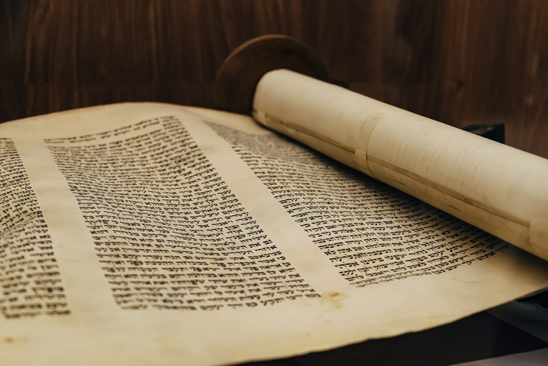
Maggid
(Fill the second cup of wine.)
Notes:
Fill the second cup of wine.

Slide 13
Ha Lachma Anya
הָא לַחְמָא עַנְיָא דִּי אֲכָלוּ אַבְהָתָנָא בְאַרְעָא דְמִצְרָיִם.
Ha lachma anya di achalu av’hatana
b’ar’a d’metzrayim
This is the bread of affliction, the poor bread, which our ancestors ate in the land of Egypt.

Slide 14
Ha Lachma Anya
Let all who are in want share the hope of Passover. As we celebrate here, we join with our people everywhere. This year we celebrate here. Next year in the land of Israel. Now we are all still in bonds. Next year may all be free.

Slide 15
The Four Questions

Slide 16
The Four Questions
מַה נִּשְׁתַּנָּה הַלַּיְלָה הַזֶּה מִכָּל הַלֵּילוֹת?
Mah nishtanah halailah hazeh mikol haleilot?
How is this night different from all other nights?

Slide 17
The Four Questions
שֶׁבְּכָל הַלֵּילוֹת אָנוּ אוֹכְלִין חָמֵץ וּמַצָּה
הַלַּיְלָה הַזֶּה – כֻּלּוֹ מַצָּה.
Sheb'chol haleilot anu ochlin chametz umatzah, halailah hazeh-kuloh matzah.
On all other nights, we eat chametz and matzah, on this night, only matzah?

Slide 18
The Four Questions
שֶׁבְּכָל הַלֵּילוֹת אָֽנוּ אוֹכְלִין שְׁאָר יְרָקוֹת
הַלַּֽיְלָה הַזֶּה – מָרוֹר.
Sheb'chol haleilot anu ochlin sh'ar y'rakot, halailah hazeh, maror.
On all other nights, we eat all vegetables. Why, on this night, maror?

Slide 19
The Four Questions
שֶׁבְּכָל הַלֵּילוֹת אֵין אָנוּ מַטְבִּילִין אֲפִילוּ פַּעַם אֶחָת
הַלַּיְלָה הַזֶּה – שְׁתֵּי פְעָמִים.
Sheb'chol haleilot ein anu matbilin afilu pa’am achat halailah hazeh-sh’tei f’amim.
On all other nights, we don’t dip our food even once, and on this night we dip twice.

Slide 20
The Four Questions
שֶׁבְּכָל הַלֵּילוֹת אָֽנוּ אוֹכְלִין בֵּין יוֹשְׁבִין וּבֵין מְסֻבִּין
הַלַּֽיְלָה הַזֶּה – כֻּלָּֽנוּ מְסֻבִּין.
Sheb'chol haleilot anu ochlin bein yoshvin uvein m'subin, halailah hazeh-kulanu m'subin.
On all other nights, we eat either sitting upright or reclining. Why on this night do we all recline?

Slide 21
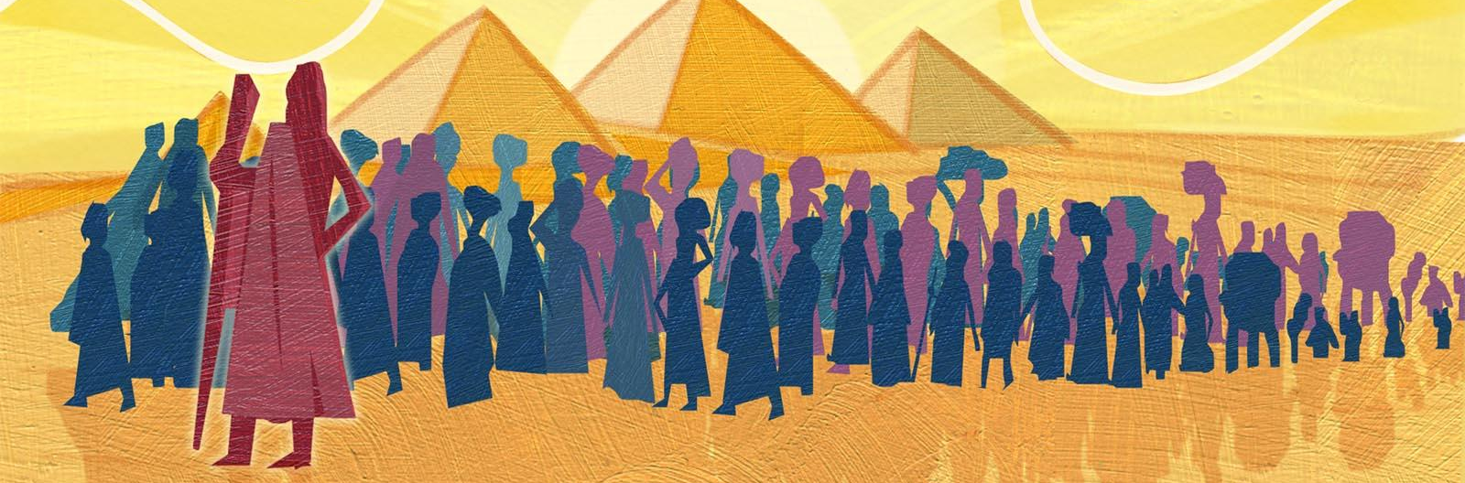
Avadim Hayinu
We were slaves to Pharaoh in the land of Egypt. And Adonai, our God, took us out from there with a strong hand and an outstretched arm. And if the Holy One had not taken our ancestors from Egypt, we and our children and our children's children would all be enslaved to Pharaoh. And even if we were all sages, all discerning, all elders, all knowledgeable about the Torah, it would be a commandment upon us to tell the story of the exodus from Egypt.

Slide 22
The Four Children
The wise child asks, “What are the laws which God commanded us?”
In response, we teach this child the rules of observing the holiday of Passover.
The wicked child asks, “What does this service mean to you?”
This child is not actually wicked but phrases his/her question without including him/herself. This indicates that he/she does not see him/herself as part of the community. We teach this child that Passover is all about seeing ourselves as if we all lived through the Exodus from Egypt and all experienced the parting of the Red Sea.

Slide 23
The Four Children
The simple child asks, “What is this?”
This child is asking the most fundamental question, “What is this seder all about, why do we do it?” We might answer this child, “With a strong hand God took us out of Egypt, where we were slaves.”
For the child who doesn’t know how to ask or what to ask…
We can help this child by telling the story...

Slide 24
Arami Oved Avi
My father was a fugitive Aramean. He went down to Egypt with meager numbers and sojourned there, and there became a great and populous nation. The Egyptians dealt harshly with us and oppressed us; they imposed heavy labor upon us. We cried to Adonai, the God of our ancestors, and Adonai heard our plea and saw our plight, our misery, and our oppression. Adonai freed us from Egypt by a mighty hand, by an outstretched arm and awesome power, and by signs and portents.

Slide 25
The Ten Plagues
Dam
Blood

Slide 26
The Ten Plagues
Tzfardeiya
Frogs

Slide 27
The Ten Plagues
Kinim
Lice

Slide 28
The Ten Plagues
Arov
Beasts

Slide 29
The Ten Plagues
Dever
Cattle Disease

Slide 30
The Ten Plagues
Sh’chin
Boils

Slide 31
The Ten Plagues
Barad
Hail

Slide 32
The Ten Plagues
Arbeh
Locusts

Slide 33
The Ten Plagues
Choshech
Darkness

Slide 34
The Ten Plagues
Makat B’chorot
Death of the Firstborn

Slide 35
Dayeinu
Ilu ilu hotzianu, hotzianu miMitzrayim, hotzianu miMitzrayim--dayeinu.
Dai dayeinu, dai dayeinu,
Dai dayeinu, dayenu dayenu

Slide 36
Dayeinu
Ilu ilu natan lanu, natan lanu et haShabbat natan lanu et haShabbat dayeinu
Dai dayeinu, dai dayeinu,
Dai dayeinu, dayenu dayenu

Slide 37
Dayeinu
Ilu ilu natan lanu, natan lanu et haTorah,
natan lanu et hatorah dayeinu.
Dai dayeinu, dai dayeinu,
Dai dayeinu, dayenu dayenu

Slide 38
At Your “Seder Tables”
What would be enough?

Slide 39
Pesach, Matzah, Maror

Slide 40
Pesach, Matzah, Maror
Rabban Gamliel would say that whoever didn’t explain the pesach, matzah, and maror during the seder hasn’t done Passover justice:
The pesach reminds us that it is important to set aside time to mark sacred occasions and make time for joining together as a community.
The matzah reminds us to clear out the chametz in our lives and make space for what could be.
The maror awakens us to do what we can do to help ease the harshness in our world.

Slide 41
B’chol Dor Vador
In every generation, everyone is obligated to see themselves as though they personally left Egypt.

Slide 42
B’chol Dor Vador
The seder reminds us that it was not only our ancestors whom God redeemed; God redeemed us along with them. That is why the Torah says, “God brought us out from there in order to give us the land promised to our ancestors.” We praise God, Ruler of Everything, who redeemed us and our ancestors from Egypt, enabling us to reach this night and eat matzah and bitter herbs.

Slide 43
Second Cup of Wine
בָּרוּךְ אַתָּה יְיָ, אֱלֹהֵינוּ מֶלֶךְ הָעוֹלָם, בּוֹרֵא פְּרִי הַגָּפֶן.
Baruch atah, Adonai Eloheinu melech ha-olam, borei p’ree hagafen.
Blessed are you, Adonai our God, Sovereign of the Universe, who creates fruit of the vine.

Slide 44
Rachtzah - Handwashing
בָּרוּךְ אַתָּה יְיָ, אֱלֹהֵינוּ מֶלֶךְ הָעוֹלָם, אֲשֶׁר קִדְּשָׁנוּ בְּמִצְוֹתָיו וְצִוָּנוּ עַל נְטִילַת יָדַיִם.
Baruch atah Adonai, Eloheinu melech ha-olam, asher kidshanu b’mitzvotav v’tzivanu al n’tilat yadayim.
Blessed are you, Adonai our God, Sovereign of the Universe, who has sanctified with Your mitzvot and has commanded us on the washing of our hands.

Slide 45
Motzi
בָּרוּךְ אַתָּה יְיָ, אֱלֹהֵינוּ מֶלֶךְ הָעוֹלָם, הַמּוֹצִיא לֶחֶם מִן הָאָרֶץ.
Baruch Atah Adonai, Eloheinu Meleh ha-olam, ha-motzi lechem min ha-aretz.
We praise You, Adonai our God, Sovereign of the Universe, Who brings forth bread from the earth.

Slide 46
Matzah
בָּרוּךְ אַתָּה יְיָ, אֱלֹהֵינוּ מֶלֶךְ הָעוֹלָם, אֲשֶׁר קִדְּשָׁנוּ בְּמִצְוֹתָיו וְצִוָּנוּ עַל אֲכִילַת מַצָּה.
Baruch Atah Adonai Eloheinu Meleh ha-olam, asher kidshanu b’mitzvo-tav v’tzivanu al achilat matzah.
We praise You, Adonai our God, Sovereign of the Universe, Who hallows our lives with commandments, Who has commanded us regarding the eating of matzah.

Slide 47
Maror
בָּרוּךְ אַתָּה יְיָ, אֱלֹהֵינוּ מֶלֶךְ הָעוֹלָם, אֲשֶׁר קִדְּשָנוּ בְּמִצְוֹתָיו וְצִוָּנוּ עַל אֲכִילַת מָרוֹר.
Baruch Atah Adonai Eloheinu Meleh ha-olam asher kidshanu b’mitzvo-tav v’tzivanu al achilat maror.
We praise You, Adonai our God, Sovereign of the Universe, Who hallows our lives through commandments, Who has commanded us regarding the eating of maror.

Slide 48
Korech - Hillel’s sandwich

Slide 49
At Your “Seder Tables”
Shulchan Orech
The Festive Meal

Slide 50
At Your “Seder Tables”
What’s the funniest, sweetest or most poignant memory from a Seder you’ve attended? If this is your first one, what has been most surprising for you so far?
Who taught you your most important lesson about freedom? What was it?
What issue or event bothers you the most in the world right now? What will you do this year to bring about healing or change?

Slide 51
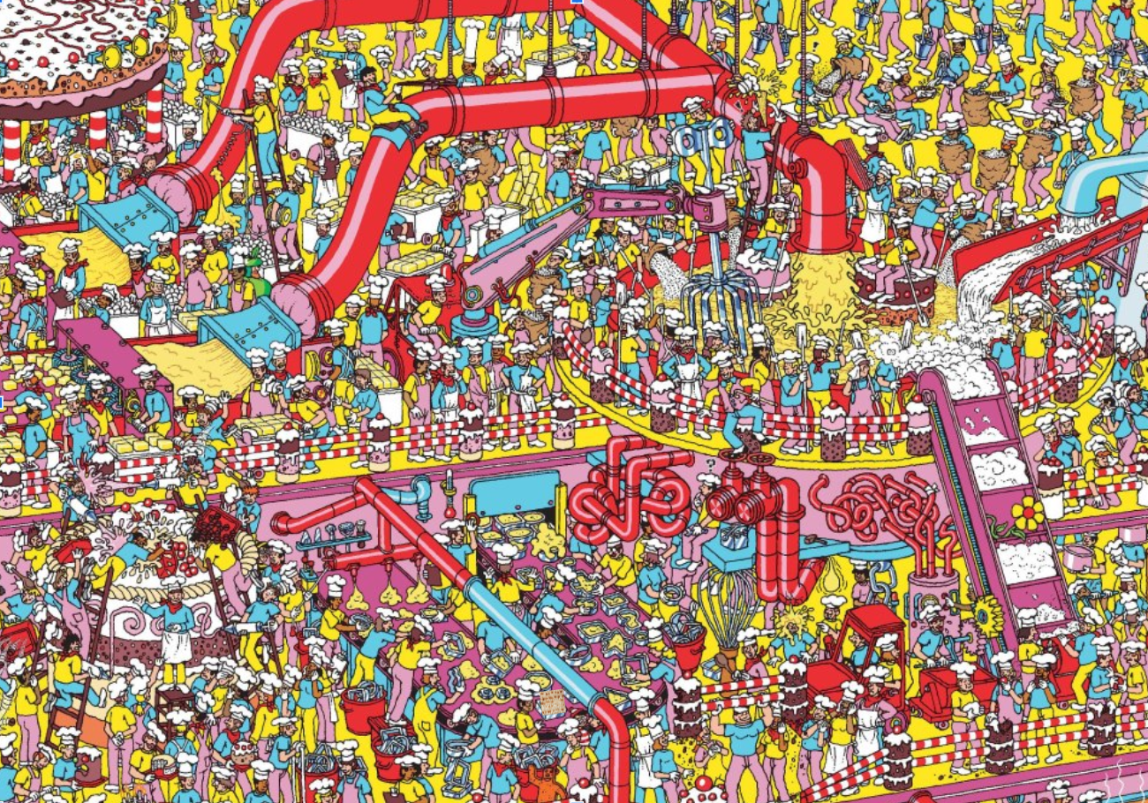

Slide 52
Barech
בְּרִיך רַחֲמָנָא מַלְכָּא דְעַלְמָא מָרֵיהּ דְהַאי פִּיתָּא.
B’rich rachamanah malka d’alma marei d’hai pita.
Blessed is the Merciful One, Sovereign of the Universe, Creator of this Bread.

Slide 53
Third Cup of Wine
בָּרוּךְ אַתָּה יְיָ, אֱלֹהֵינוּ מֶלֶךְ הָעוֹלָם, בּוֹרֵא פְּרִי הַגָּפֶן.
Baruch atah, Adonai Eloheinu melech ha-olam, borei p’ree hagafen.
Blessed are you, Adonai our God, Sovereign of the Universe, who creates fruit of the vine.

Slide 54
Open the Door for Elijah

Slide 55
Eliyahu Hanavi
Eliyahu hanavi
Eliyahu hatishbi
Eliyahu, Eliyahu, Eliyahu hagil’adi
Bim’hera v’yameinu, yavoh eleinu
im mashiach ben David,
im mashiach ben David.

Slide 56
Hallel – Psalms of Praise
B'tzeit Yis-ra-eil mi-Mitz-ra-yim Beit Ya-a-kov mei-am lo-eiz Ha-y'ta (2x) Y'hu-da l'kod-sho
Yis-ra-eil mam-sh'lo-tav
Ha-yam (2x) ra-a va-ya-nos –
Ha-Yar-dein yi-sov l'a-chor He-ha-rim rak'du ch'ei-lim
g'va-ot kiv-nei tzon

Slide 57
Hallel – Psalms of Praise
Hallelu
Kol Han’shama t’hallel-Ya
Hallelu Halleluya

Slide 58
Fourth Cup of Wine
בָּרוּךְ אַתָּה יְיָ, אֱלֹהֵינוּ מֶלֶךְ הָעוֹלָם, בּוֹרֵא פְּרִי הַגָּפֶן.
Baruch atah Adonai, Eloheinu melech ha-olam, borei p’ree hagafen.
Blessed are you, Adonai our God, Sovereign of the Universe, who creates fruit of the vine.

Slide 59
Nirtzah – Conclusion
LEADER: The Seder now concludes: Its rites observed in full, its purposes revealed
GROUP: This privilege we share will ever be renewed. Until God’s plan is known in full, God’s highest blessing sealed:

Slide 60
Nirtzah – Conclusion
LEADER: The blessing of peace!
GROUP: Peace for us! For everyone!
LEADER: For all people, this, our hope.
GROUP: Next year in Jerusalem! Next year may we all be free!

Slide 61
L’shanah Haba’ah B’Yerushalayim

Slide 62
Adir Hu
Adir hu yivneh beito bekarov. Bimherah, bimherah,
beyameinu bekarov. El bneh, el bneh,
bneh beitcha bekarov.
אַדִּיר הוּא יִבְנֶה בֵּיתוֹ בְּקָרוֹב. בִּמְהֵרָה,בִּמְהֵרָה, בְּיָמֵינוּ בְּקָרוֹב. אֵל בְּנֵה, אֵל בְּנֵה, בְּנֵה בֵּיתְךָ בְּקָרוֹב.
God of Might, God of Right,
We would bow before Thee
Sing Thy praise in these days,
Celebrate Thy glory,
As we hear, year by year,
Freedom’s wonderous story.

Slide 63
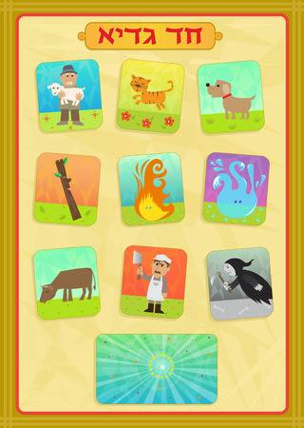
Chad Gadya
One little kid, one little kid that my father bought for two zuzim. Chad Gadya…
Then came the cat that ate the kid
Then came the dog and bit the cat…
Then came the stick and beat the dog…

Slide 64
Chad Gadya
Then came the fire and burned the stick…
Then came the water and quenched the fire…
Then came the ox and drank the water…
Then came the butcher and killed the ox…

Slide 65
Chad Gadya
Then came the angel of death and slew the butcher...
Then came the Holy One, blessed be God, And destroyed the angel of death…

